Slide 1
U(x_{i}, t_{n}) = U_{i}^{n}
time step n+1
time step n
t
U₀^{n+1}
U_{i-1}^{n+1}
U_{i}^{n+1}
U_{i+1}^{n+1}
U_{i}^{n+1}
Δt
U₀^{n}
U_{i-1}^{n}
U_{i}^{n}
U_{i+1}^{n}
U_{I}^{n}
Δx
x₀
x_{i-1}
x_{i}
x_{i+1}
x_{I}
x

Slide 2
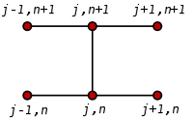
U(x_{i}, t_{n}) = U_{i}^{n}
time step n+1
time step n
t
U₀^{n+1}
U_{i-1}^{n+1}
U_{i}^{n+1}
U_{i+1}^{n+1}
U_{i}^{n+1}
Δt
U₀^{n}
U_{i-1}^{n}
U_{i+1}^{n}
U_{I}^{n}
Δx
U_{i}^{n}
x₀
x_{i-1}
x_{i}
x_{i+1}
x_{I}
x

Slide 3
t
n+1
n
U₀^{n+1}
U_{i-1}^{n+1}
U_{i}^{n+1}
U_{i+1}^{n+1}
U_{i}^{n+1}
Δt
U₀^{n}
U_{i-1}^{n}
U_{i+1}^{n}
U_{I}^{n}
Δx
U_{i}^{n}
x₀
x_{i-1}
x_{i}
x_{i+1}
x_{I}
x

Slide 5
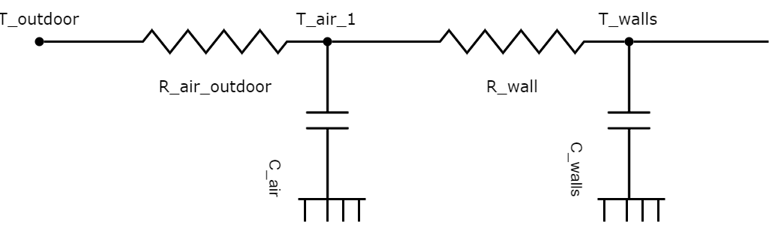
T_{amb}
T_{air}
T_{wall}
R_{air, amb}
R_{air, wall}
C_{air}
C_{wall}

Slide 6
R_{0, amb}
R₀₁
T_{amb}
C₀
C₁
air
construction

Slide 7
R_{3, amb}
R₂₃
1st floor
T_{amb}
C₃
C₂
R₁₂
R_{0, amb}
R₀₁
T_{amb}
C₀
C₁
ground
floor

Slide 8
R₂₃
Q_{inst}
C₂
C₃
1/R₀₂₌U*A
R_{0, amb}
R₀₁
T_{amb}
C₀
C₁
C_{0:} air
C_{1:} wall
C_{2:} rad
C_{3:} buf
ground
floor

Slide 9
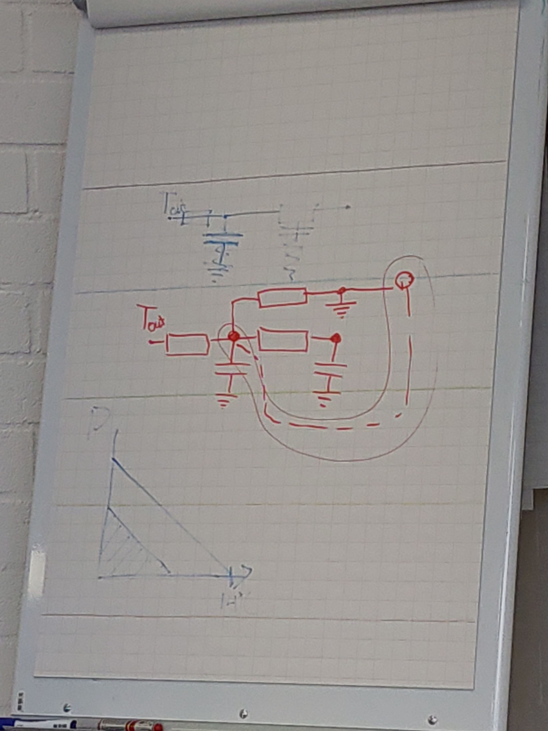




Q_{inst}
C₂
1/R₀₂=U*A
C_{0:} air
C_{1:} wall
C_{2:} radiator
R_{0, amb}
R₀₁
T_{amb}
C₀
C₁
ground
floor

Slide 10
1/R₀₂
=
U*A
Q_{inst}
C₂
C_{0:} air
C_{1:} wall
C_{2:} radiator
R_{0, amb}
R₀₁
T_{amb}
C₀
C₁

Slide 11
R_{2, amb}
R₂₃
1st floor
T_{amb}
C₂
C₃
C₀: air, gf
C₁: wall, gf
C₂: air, ff
C₃: wall, ff
R₁₃: R _{gf, ff}
R₁₃
R_{0, amb}
R₀₁
T_{amb}
C₀
C₁
ground
floor

Slide 12
R_{3, amb}
R₂₃
1st floor
T_{amb}
C₃
C₂
C₀: air, gf
C₁: wall, gf
C₃: air, ff
C₂: wall, ff
R₁₂: R _{gf, ff}
R₁₂
R_{0, amb}
R₀₁
T_{amb}
C₀
C₁
ground
floor

Slide 13
These circuit symbols are for drawing schematics in PowerPoint. For an example, see the next chart.
Component circuit symbols here are “groups” to retain their integrity under translation and rotation and shrinking.
To revise a symbol, use PowerPoint’s Home::Arrange::Ungroup function and then regroup when done.
Enjoy!
-Mike Lampton

Slide 14
Neon Lamp power supply
+28v
7815
+15v
7555
100kHz 15vpp square wave
200KΩ
10KΩ
Lamp current monitor
return
Concept: 9-stage voltage multiplier from 100kHz square wave oscillator
Input: 28vDC at 5mA; range 18 to 36v allowable.
Lamp: up to 120vdc to start; 300uA available at 60v lamp drop
Monitor: 10K resistor providing lamp current monitor
Series safety: 100 ohm series input resistor to limit power-on surge current
Shunt safety: One TranSorb input safety zener for example JAN-1N6120
ICs: One 7815 input regulator; one 7555 oscillator
Rectifiers: 18 fast recovery diodes, for example JAN-1N4148

Slide 15
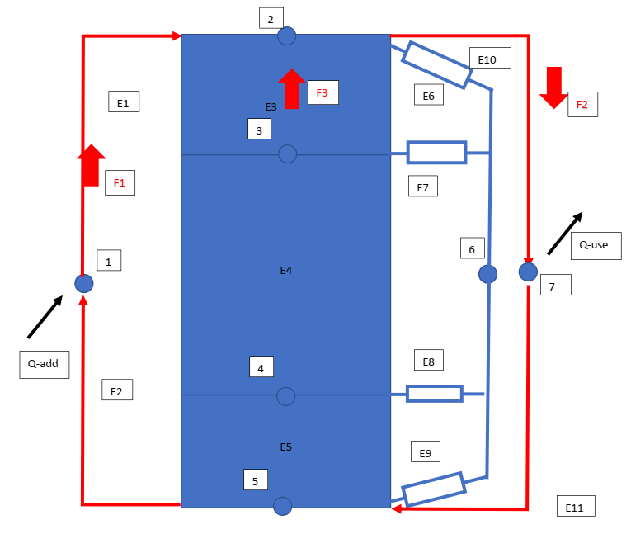
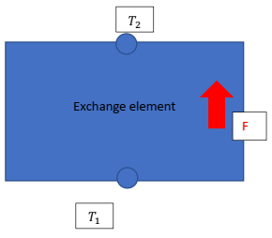
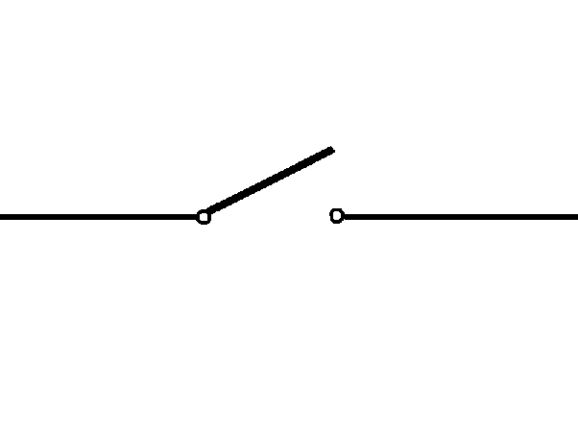
R_{th} = inf, C= 0
R_{th} = 0, C= inf
T_{amb}

Slide 16
R_{th} = inf, 1/R_{th} = 0
R_{th} = inf, C= 0
R_{th} = 0, 1/R_{th}= inf
R_{th} = 0, C= inf
T_{amb}
T_{amb}

Slide 17
R_{th} = inf, 1/R_{th} = 0
R_{th} = inf, C= 0
R_{th} = 0, 1/R_{th}= inf
R_{th} = 0, C= inf
interface
amb-air
air
interface air-wall
wall
R_{a,a}
R_{air}
R_{a,w}
R_{wall}
T_{amb}
T_{amb}
0
1
2
3
4
C_{a,a} =0
C_{air}
C_{a,w} =0
C_{wall}

Slide 18
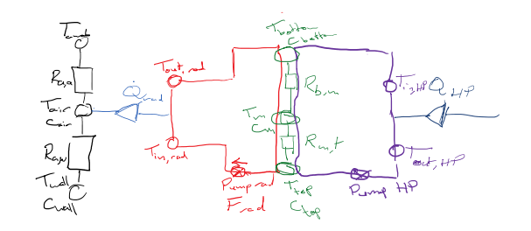

Slide 19
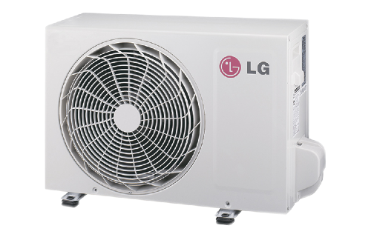

T_{amb}
T_{top}
T_{evap, in}
T_{feed}
C_{top}
R_{0, amb}
T_{cond, out}
C₀
R_{mt}
$${\dot{Q}}_{rad}$$
C_{mid}
T_{return}
R₀₁
T_{cond, in}
R_{bm}
1/R₀₂
=
U*A
C_{bottom}
C₁
T_{evap, out}
Q_{inst}
C₂
T_{bottom}
_{House}
_{Buffer vessel}
_{Heat Pump}
R_{0, amb}
C_{0:} air
C_{1:} wall
C_{2:} radiator

Slide 20

T_{amb}
T_{top}
F_{HP}
T_{evap, in}
F_{rad}
T_{feed}
C_{top}
R_{0, amb}
T_{cond, out}
C₀
R_{mt}
$${\dot{Q}}_{rad}$$
C_{mid}
T_{return}
R₀₁
T_{cond, in}
R_{bm}
C_{bottom}
C₁
T_{evap, out}
T_{bottom}
_{House}
_{Buffer vessel}
_{Heat Pump}

Slide 21
T_{amb}
T_{top}
F_{HP}
T_{evap, in}
F_{rad}
T_{feed}
R_{0, amb}
C_{top}
T_{cond, out}
C₀
R_{mt}
$${\dot{Q}}_{rad}$$
C_{mid}
T_{return}
R₀₁
T_{cond, in}
R_{bm}
C₁
C_{bottom}
T_{evap, out}
T_{bottom}
_{House}
_{Radiator}
_{Buffer vessel}
_{Heat Pump}

Slide 22
house module
list of thermal capacities related to the parts of the house (air, walls)
label
heat capacity
list of heat conductance between two capacities
label
conductance value
label capacity 1
label capacity 2
create a network and the conductance matrix and C-matrix

Slide 23
buffer vessel
list of thermal capacities representing the layers in the vessel with heat exchange by conductance and flow induced convection
nr of layers
capacities (as in house)
conductances (as in house)
→ contribution to conductance matrix and C-matrix
flows
label
heat capacity of medium (water)
ordered list of capacity labels (order of the direction of the flow)
flow size (can be changed by control function)
flow end points ( nodes that need to be connected to other model parts to close the flow loop)
→ flow matrix, which can be added to the conductance matrix
flow matrix is time dependent due to control on the flow rate (flow rate will be piece-wise constant)

Slide 24
predefined temperatures
predefined temperature is a node with fixed (or piece-wise constant) temperature, connected to one or more capacities by a conductance link
node label
temperature value:
time stamp start
temperature
connected nodes:
node label
conductance
contribution in the Qdot vector + diagonal matrix which can be added to the conductance matrix

Slide 25
radiator
element that connects a flow to a thermal capacity node
label
in-flow
label connected node
temperature connected node
out-flow
label connected node
connected capacity
label node
temperature connected node
internal:
equation for heat transfer, depending on temperature in flow and connected capacity
yields heat transfered and return temperature
→ contributing to Qdot vector at connected node and at node connected to return flow

Slide 26
heat pump
element connecting two flows
label
max-power
CoP
in-flow cond
label connected node
temperature
out-flow cond
label connected node
temperature
in-flow evap
temperature
out-flow evap
temperature
internal: non-linear equation for heat-transfer between the two flows
computes heat transfer

